Slide 1
INSURANCE PORTFOLIO ANALYSIS
Submitted by
Meena R

Slide 2
SQL
SQL, which stands for Structured Query Language is a standardized programming language used for managing and manipulating relational databases.
It allows users to perform various operations on the data stored in databases, such as querying, updating, inserting, and deleting data.
SQL is used to communicate with a database.

Slide 3
FEATURES
Relational Database Management System (RDBMS)
Easy to use
Storing Data is secure
Open Source & Free to download
Compatible on many Operating systems.

Slide 4
DBMS
DBMS is a collection of data.
Database management systems are software systems used to store, retrieve, and run queries on data. A DBMS serves as an interface between a end user and a database, allowing user performing CRUD operations.
CRUD operations are
Create
Rename
Update
Delete

Slide 5
RDBMS
RDBMS stands for Relational Database Management Systems.
It is a program that allows us to create, delete, and update a relational database.
A Relational Database is a database system that stores and retrieves data in a tabular format organized in the form of rows and columns.

Slide 6
SQL STATEMENTS
DATA DEFINITION LANGUAGE (DDL)
DATA MANIPULATION LANGUAGE (DML)
TRANSACTION CONTROL LANGUAGE (TCL)
DATA QUERY LANGUAGE (DQL)

Slide 7
DATA TYPES
NUMERIC DATA TYPE
STRING DATA TYPE
DATE AND TIME
PICTURE SAVING

Slide 8
TABLE CREATIONS
TABLE 1
create table loan_sts(loan_id varchar(55),customer_id varchar(70),Loan_amount varchar(90),Loan_amount_term int,cibil_score int);
TABLE 2
create table remark_criteria(loan_id varchar(55),loan_amount varchar(90),cibil_score int,cibil_score_sts varchar(90));

Slide 9
CREATE TRIGGERS
Timings:
Before insert (Row level trigger)
After insert (Statement level trigger)
Before insert:
delimiter $$
create trigger loan_amount_check before insert on loan_sts for each row
Begin
if new.loan_amount is null
then set new.loan_amount= 'Loan still processing’;
end if;
end $$delimiter ;

Slide 10
AFTER INSERT
delimiter $$
create trigger cibil_check after insert on loan_sts for each row
Begin
if new.cibil_score>900 then insert into remark_criteria (loan_id,loan_amount,cibil_score,cibil_score_sts)values
(new.loan_id,new.loan_amount,new.cibil_score,'High cibil score’);
elseif new.cibil_score>750 then insert into remark_criteria (loan_id,loan_amount,cibil_score,cibil_score_sts)values
(new.loan_id,new.loan_amount,new.cibil_score,'No penalty’);
elseif new.cibil_score>250 then insert into remark_criteria

Slide 11
(loan_id,loan_amount,cibil_score,cibil_score_sts)values
(new.loan_id,new.loan_amount,new.cibil_score,'Penalty customers’);
elseif new.cibil_score<=0 then insert into remark_criteria (loan_id,loan_amount,cibil_score,cibil_score_sts) values (new.loan_id,new.loan_amount,new.cibil_score,'Reject customer (Loan not apply)’);
end if;
end $$
delimiter ;

Slide 12
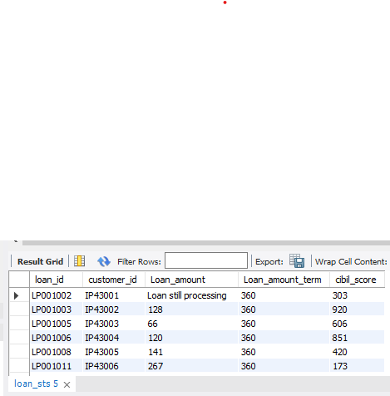
INSERTING VALUES
TABLE 1:
insert into loan_sts values();
OUTPUT:

Slide 13
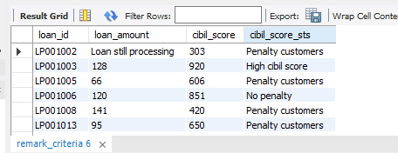
TABLE 2 (USING TRIGGERS)
OUTPUT:

Slide 14
JOINS
A JOIN clause is used to combine rows from two or more tables, based on a related column between them.
Types of Joins are:
INNER JOIN
LEFT JOIN
RIGHT JOIN
FULL OUTER JOIN
CROSS JOIN

Slide 15
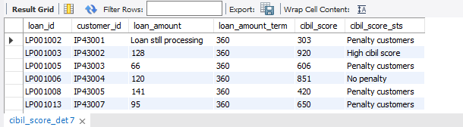
QUERY (TABLE3)
create table cibil_score_det select l.loan_id,l.customer_id,l.loan_amount,l.loan_amount_term,l.cibil_score,r.cibil_score_stsfrom loan_sts as l inner join remark_criteria as r on l.loan_id=r.loan_id;

Slide 16
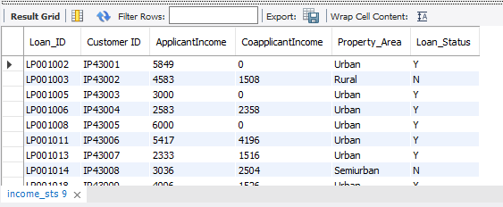
IMPORT TABLE
Four tables are importing in same database.
QUERY:
select * from income_sts;

Slide 17
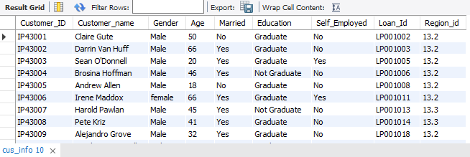
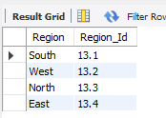
select * from cus_info;
select * from region_info;

Slide 18
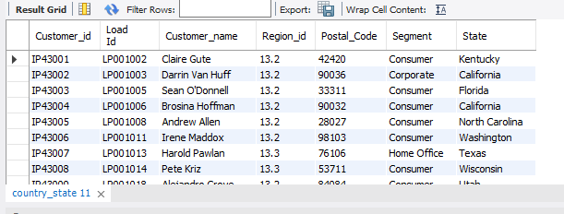
select * from country_state;

Slide 19
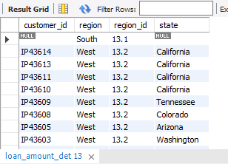
1st region and country_state tables are using left join.
Query:
create table loan_amount_det select cs.customer_id,r.region,r.region_id,cs.state from region_info
as r left join country_state as cs on r.region_id=cs.region_id;

Slide 20
This table joined with balance 2 tables and TABLE 3 are joining
using inner join.
QUERY:
create table table_4 select c.customer_id,i.applicantincome,i.property_area,c.cibil_score,
c.loan_amount,ci.gender,ci.customer_name,cs.state,l.region,l.region_id
from cibil_score_det as c inner join income_sts as i on c.loan_id=i.loan_id inner join country_state as cs on c.customer_id=cs.customer_id inner join cus_info as ci on
c.loan_id=ci.loan_id inner join loan_amount_det as l on c.customer_id=l.customer_id;

Slide 21
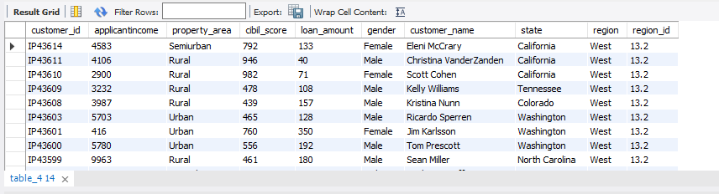
OUTPUT:

Slide 22
CASE END & CASE AND
QUERY
create table table_5
select *, case
when applicantincome>15000 then 'A grade’
when applicantincome>9000 then 'B grade’
when applicantincome>5000 then 'middle class customer
'else 'Low class customer’
end as customer_criteria ,

Slide 23
case
when applicantincome<5000 and property_area='Rural’ then ‘5’
when applicantincome<5000 and property_area= 'semi Rural' then '3.5’
when applicantincome<5000 and property_area='Urban' then ‘3’
when applicantincome<5000 and property_area='Semiurban' then '2.5’
else ‘7’
end as monthly_interest from table_4;

Slide 24
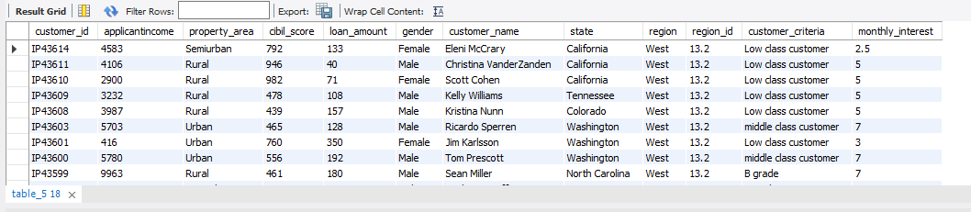
OUTPUT:

Slide 25
DELETE STATEMENT:
The DELETE command refers to a data manipulation language (DML) command that is used to remove the records present in a table.
DELETE statements are used to delete particular data when using where condition.
If where condition not used in delete statement it deletes all data’s from a table.

Slide 26
QUERY:
delete from table_5 where loan_amount ='Loan still processing’;
Using delete statement,
We delete ‘Loan still processing’ are deleted In loan_amount column.

Slide 27
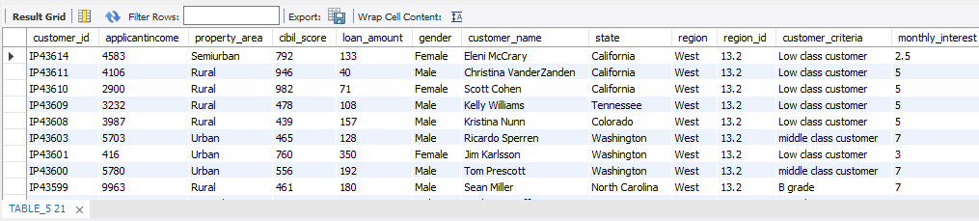
OUTPUT:

Slide 28
Calculating Monthly & Annual_interest_amount:
Calculating monthly and annual_interest_amount and it add with Previous table and convert as a new table.
Query:
create table table_6 select * , round((loan_amount*monthly_interest/100),0)as monthly_interest_amount, round((loan_amount*monthly_interest/100)*12,0) as Annual_interest_amount from table_5;

Slide 29
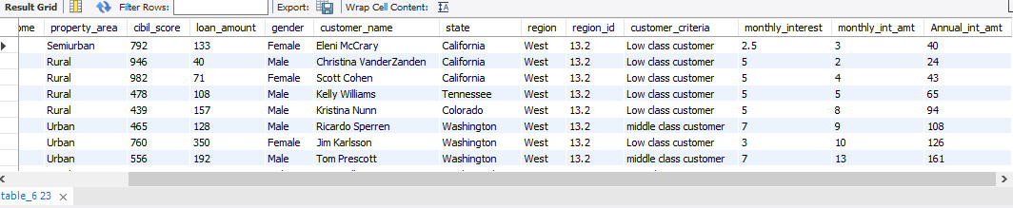
Here, we using round() function.
It is one of the STRING FUNCTION . It mainly used for rounds a number to a specified number of digits.
OUTPUT:

Slide 30
Count() function
The COUNT() function returns the number of records returned by a select query.
NULL values are not counted.
To count the number of rows in a table, use the COUNT(*) function.
It is one of the Aggregation or calculate function.
QUERY:
select state , count(customer_id) as no_of_cus from table_4 group by state;

Slide 31
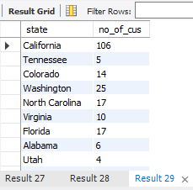
OUTPUT:

Slide 32
SUM() FUNCTION
It is one of the aggregate function or calculate function.
Sum() function used to totals the values in a given column.
QUERY:
select b.state,sum(c.loan_amount) as total_loan_amount from table_4 as b inner join cibil_score_det as c on b.customer_id=c.customer_id group by b.state;
select state,sum(applicantincome) as total_income from table_4 group by state;

Slide 33
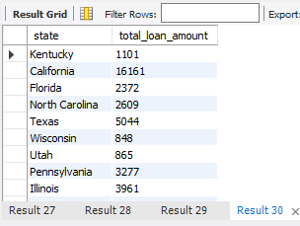
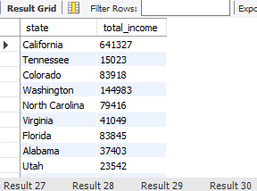
OUTPUT 1 OUTPUT 2

Slide 34
GROUP BY
A GROUP BY statement in SQL specifies that a SQL SELECT statement partitions result rows into groups, based on their values in one or several columns.
Typically, grouping is used to apply some sort of aggregate function for each group.
The result of a query using a GROUP BY statement contains one row for each group.

Slide 35
RIGHT() FUNCTION
The SQL RIGHT() function is used to retrieve the rightmost length characters from the string.
QUERY:
select customer_name,right(customer_name,4) as customer_last_name from table_5 where customer_name like '% ____’ ;
LIKE FUNCTION:
The LIKE operator is used in a WHERE clause to search for a
Specified pattern in a column.

Slide 36
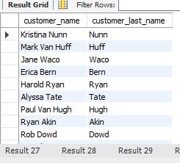
OUTPUT:

Slide 37
STORED PROCEDURE
A stored procedure is a prepared sql code that you can save.
So the code can be reused over and over again.
So if you have an SQL query that you write over and over again
Save it as a stored procedure,and then just call it to execute it.

Slide 38
QUERY:
delimiter $$
create procedure loan_details()
Begin
select c.customer_id,i.applicantincome,i.property_area,c.cibil_score,
ci.gender, ci.customer_name,cs.state ,l.region,l.region_id from cibil_score_det as c
inner join income_sts as i on c.loan_id=i.loan_id inner join country_state as cs on c.customer_id=cs.customer_id inner join cus_info as ci on c.loan_id=ci.loan_id inner join loan_amount_det as l on c.customer_id=l.customer_id;
select * from table_6;
select state,count(customer_id) as no_of_cus from table_4 group by state;

Slide 39
select state,count(customer_id) as no_of_cus from table_4 group by state;
select state,count(customer_id) as no_of_cus from table_4 group by state;
select b.state,sum(c.loan_amount) as total_loan_amount from table_4 as b inner join cibil_score_det as c on b.customer_id=c.customer_idgroup by b.state;
select state,sum(applicantincome) as total_income from table_4 group by state;
select customer_name,right(customer_name,4) as customer_last_name from table_5 where customer_name like '% ____’;
end $$
delimiter ;
call loan_details();

Slide 40
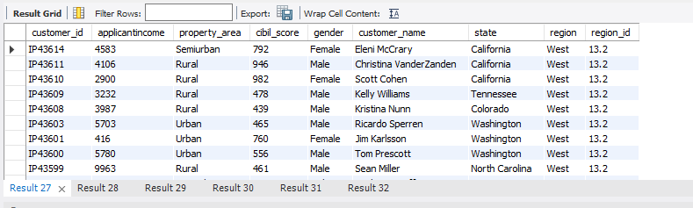
OUTPUT 1

Slide 41
OUTPUT 2

Slide 42
OUTPUT 3

Slide 43
OUTPUT 4 OUTPUT 5

Slide 44
OUTPUT 6

Slide 45
UPDATE STATEMENT
The UPDATE statement is used to update or modify data in a table.
It is used to change the values in one or more columns of a single row or multiple rows.
The update query in SQL modifies existing data in a table.

Slide 46
QUERY
update cus_info set gender='female' where customer_id='IP43006’;
update cus_info set gender='female' where customer_id='IP43016’;
update cus_info set gender='Male' where customer_id='IP43018’;
update cus_info set gender='Male' where customer_id='IP43038’;
update cus_info set gender='female' where customer_id='IP43508’;
update cus_info set gender='female' where customer_id='IP43577’;
update cus_info set gender='female' where customer_id='IP43589’;
update cus_info set gender='female' where customer_id='IP43593’;
update cus_info set age=45 where customer_id='IP43007’;
update cus_info set age=32 where customer_id='IP43009';

Slide 47



OUTPUT 1
OUTPUT 2
OUTPUT 3

Slide 48



OUTPUT 4
OUTPUT 5
OUTPUT 6

Slide 49

OUTPUT 7
OUTPUT 8

Slide 50


OUTPUT 9
OUTPUT 10

Slide 51
THANK YOU!!

